Slide 1
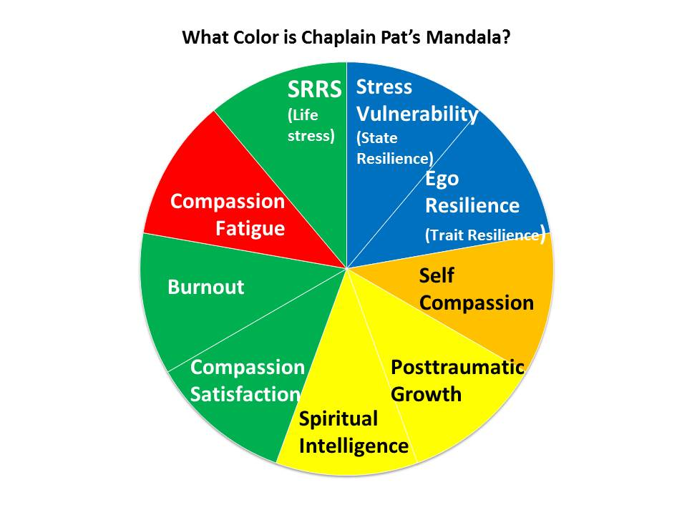
Case Study: Chaplain Pat
Due to high Compassion Fatigue Score, Pat also took the Secondary Traumatic Stress Scale.
Results indicate need for further assessment by a professional.
Blue | Very Good Health
Green | Health
Yellow | At Risk for Injury
Orange | High Injury
Red | Very High Injury

Slide 2
What are Chaplain Pat’s Current Self Care Strategies?
1.
2.
3.
1.
2.
3.
1.
2.
3.
1.
2.
3.
Pat
1.
2.
3.
1.
2.
3.
1.
2.
3.
1.
2.
3.
1.
2.
3.

Slide 3
In which areas would you recommend that Chaplain Pat develop maintenance goals? Growth goals?
1.
2.
3.
1.
2.
3.
1.
2.
3.
1.
2.
3.
Pat
1.
2.
3.
1.
2.
3.
1.
2.
3.
1.
2.
3.
1.
2.
3.

