Slide 1
Compassion Fatigue Educator
Certification Course
for
AMEDDSC U.S. Army Chaplains and Chaplain Assistants

Slide 2

Presented
2013 September 12 – 08000-01400
Ft. Sam Houston
San Antonio, Texas
by
Dr. Kathleen (Kathy) Regan Figley
President & Founder
Figley Institute

Slide 3
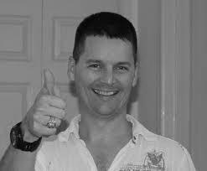
Dedication
To our friend and colleague
Lt. Col. David E. Cabrera,
Clinical Social Worker,
Uniformed Services University;
Attached to 528th Brigade U.S. Forces – Afghanistan.
Killed in action October 29, 2011,
Kabul, Afghanistan.
Photo by Charles R. Figley

Slide 4
Acknowledgements
Thanks to
CH (LTC) Charles (Chuck) B. Rizer JR.
Training Manager, Chaplain
AMEDD Center and School
Fort Sam Houston, Texas

Slide 5
Gratitude
Thank you
for your service to
wounded warriors
and
those who love them.

Slide 6
Introduction
Part I
(p. 1)

Slide 7
Agenda
Participant Guide Overview
Time | Section | Topic
0800 | Part I | Introduction
 | Part II | Definitions
 | Part III | Getting Started – Standards of Self-Care
 | Part IV | Committing to Self-Care
 | Part V | Taking the Inventories – A Baseline for Self-Care Planning
 | Part VI | Taking Action! Implementing a Self-Care Plan
1400 |  | Daily Wrap-Up

Slide 8
Course Goal (p. 1)
To provide each participant with the knowledge and skills necessary to reduce the secondary impact of working with traumatized populations.

Slide 9
A quick (humorous) stress test…
Video –
skateboarder observed incident
With whom do you identify?
Driver? Pedestrian? Skateboarders?

Slide 10
Course Objectives (p. 1)
Upon completion of the one day training, participants will be able to
Articulate the developmental history of compassion fatigue including countertransference, caregiver stress, burnout, vicarious traumatization, and secondary traumatic stress

Slide 11
Differentiate between compassion fatigue, secondary traumatic stress, and vicarious traumatization;
Articulate the unique array of symptoms indigenous to compassion fatigue;

Slide 12
Assess and identify symptoms of compassion fatigue in self and others;
Recognize compassion fatigue triggers and early warning signs;
Articulate current theoretical models for the etiology and transmission of compassion fatigue;

Slide 13
Articulate and teach others the potential effects of traumatic stress upon systems (marriage, family, workplace, etc);
Identify and utilize resources and plans for resiliency and prevention for self and ability to facilitate this plan with others;

Slide 14
Create and maintain a self-care plan for self and others and familiar with the Academy of Traumatology’s Standards of Self Care for traumatologists.
Facilitate a self-care plan for self and others;

Slide 15
Provide psycho-education on the causes, symptoms, prevention, and treatment of compassion fatigue; and
Abide by the Academy of Traumatology Standards of Practice.

Slide 16
Getting to Know You
Work in table groups
Identify volunteer to serve as group spokesperson
Spokesperson list names and duty stations of those in group on index card
Identify three major areas of work related challenges
Report out names and challenges
Turn card in to me

Slide 17
A bit about me Education
Education
  BS Psychology (1981)
  MS Counseling and Human Systems (1983)
  Certified Traumatologist (1997)
  Master Traumatologist (1999)
  Certified Compassion Fatigue Therapist (2004)
  DMin Pastoral Counseling (2008)

Slide 18
A bit about me - Experience
Field Practitioner
  Human Services and Crisis Counseling
  Crisis Intervention in the workplace
    Murder, suicide, armed robbery
Field Instructor, e.g.,
  Clinicians, first responders, emergency managers, hospital chaplains, and U.S. military (Army and Navy)

Slide 19
Agenda
Time | Section | Topic
0800 | Part I | Introduction
 | Part II | Definitions
 | Part III | Getting Started – Standards of Self-Care
 | Part IV | Committing to Self-Care
 | Part V | Taking the Inventories – A Baseline for Self-Care Planning
 | Part VI | Taking Action! Implementing a Self-Care Plan
1400 |  | Adjourn

Slide 20
Definitions
Part II
(p. 2)
Objectives 1, 2, 7

Slide 21
Video: When Helping Hurts
Available from GiftFromWithin.org*
  Short version 17 minutes
  Long version 52 minutes
  Short clips (1 – 3 minutes) available for free at the website
  *Figley Institute does not receive compensation for video sales.

Slide 22
Primary Stress Injuries (p. 2)
Acute Stress
Acute Stress Disorder
Posttraumatic Stress Disorder

Slide 23
Secondary Stress Injuries (p. 4)
Compassion Fatigue
Secondary Traumatic Stress
Vicarious Trauma

Slide 24
Burnout (p. 5)
Exhaustion mixed with anxiety and depression
Negative self-esteem
Poor attitude
Reduced efficiency
Reduced effectiveness

Slide 25
Shared Trauma (p. 5)
Affective, behavioral, cognitive, spiritual and multi-modal responses as a result of primary and secondary exposure to the same collective trauma as their clients.

Slide 26
Resilience (p. 6)
Ability to physiologically and psychologically adapt to environmental changes
Characteristic of survivors (rather than victims)

Slide 27
Post-Traumatic Growth (p. 6)
Positive changes which result from struggling to cope with a traumatic event.

Slide 28
Getting Started – Standards of Self Care
Part III
(p. 7)
Objectives 3, 5, 6 7, 11

Slide 29
Create Case Study (15 minutes)
Working in groups of 4, develop a case study profile
  Preferable that group members are of same or similar rank
Record information (see next slide)
  Create 2 index cards
    1 for your table group and 1 for me
    with the same information on both cards.
Select group spokesperson who will have 2-3 minutes to report out.

Slide 30
Report Out (Present)
In 2-3 minutes, provide the following information.
The names and duty stations of those in your group.
Case study demographics and current status
  Name, age, sex, marital status, discipline
  Current assignment; length in current assignment
  Average “caseload” seen/week
  Perceived level of work performance
  Caregiver Reactions (Table 1, p. 38)
  Healthy Coping (Table 2, p. 39)
Turn in extra index card to me when done

Slide 31
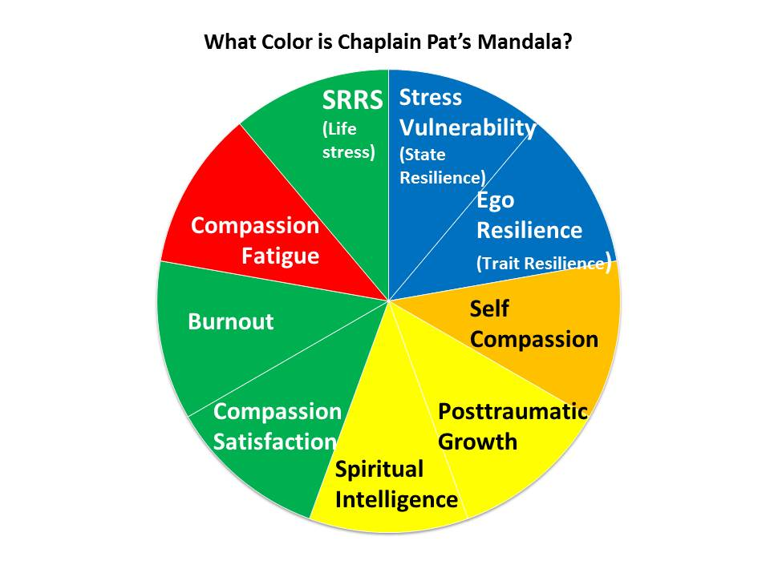
Case Study: Chaplain Pat
Due to high Compassion Fatigue Score, Pat also took the Secondary Traumatic Stress Scale.
Results indicate need for further assessment by a professional.
Blue | Very Good Health
Green | Health
Yellow | At Risk for Injury
Orange | High Injury
Red | Very High Injury

Slide 32
SoSC-I. Purpose of Guidelines (p. 7)
Do no harm to self in line of duty.
Attend to needs
Physical
Social
Emotional
Spiritual

Slide 33
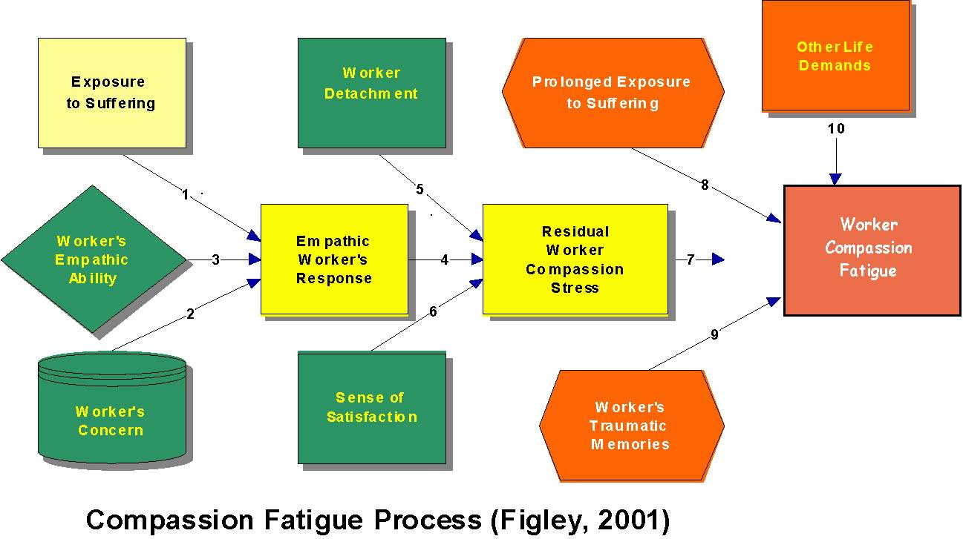
Model of Compassion Stress and Fatigue (p. 44)

Slide 34
SoSC-II. Ethical Principles (p. 7)
Do no harm!
Compassion Fatigue has been linked to ethical errors therefore
It is unethical to neglect self care

Slide 35
SoSC-III. Humane Practice of Self Care (p. 7)
Wellness
Physical rest and nourishment
Emotional rest and nourishment
Sustenance modulation

Slide 36
SoSC-IV. Appreciation and Compensation (p. 7)
Increased satisfaction sustains workers emotionally and spiritually
  In what ways does the Army meet needs for recognition and compensation?
Select one or more advocates
  “accountability buddy”

Slide 37
Committing to Self Care
Part IV
(p. 8)
Objectives 6, 8

Slide 38
SoSC-V. Establishing and Maintaining Wellness (p. 8)
Commitment to self care
Strategies for letting go of work
Strategies for gaining a sense of achievement

Slide 39
Caregiver Resilience Model
(p. 45)

Slide 40
Attitude is everything
Run time 3:16
Options
  Watch the clip or
  Close eyes and enjoy the music or
  Relax for three minutes

Slide 41
Taking the Inventories –
A Baseline for elf-Care Planning
Part V
(p. 8)
Objectives 3, 4, 5, 7, 8, 9,10

Slide 42
SoSC-VI. Inventory of Self-Care Practice – Personal (p. 8)
Physical
Psychological
Social/Interpersonal

Slide 43
Self-Assessments (SA 1-6) p. 11
Social Readjustment Rating Scale
How Vulnerable are you to Stress?
Ego Resiliency
Self-Compassion
Posttraumatic Growth Inventory
Spiritual Intelligence

Slide 44
Caregiver Resilience Model
(p. 45)

Slide 45
SoSC-VII. Inventory of Self-Care Practice - Professional (p. 9)
SA-7 ProQOL
  Compassion Satisfaction
  Compassion Fatigue
  Burnout
SA-8 Secondary Traumatic Stress Scale
  Secondary Traumatic Stress
    Intrusion
    Avoidance
    Arousal

Slide 46
Activity: Case Study
Each group will complete self-assessments their case study
Minimum:
Social Readjustment Rating Scale
How Vulnerable are you to stress?
Ego Resilience
ProQOL

Slide 47
Taking Action! Implementing a
Self-Care Plan
Part VI
(p. 10)
Objectives 9, 10, 11, 12

Slide 48
Chaplain Pat
SRRS = 37% change of developing minor illness in next two years
Stress vulnerability (state resilience) = Excellent resistance to stress
Ego resilience = very high trait resilience

Slide 49
Chaplain Pat (continued)
Self Compassion = moderate (beats self up sometimes for making mistakes)
Posttraumatic growth = small degree
  Note: Pat had serious incident in past when transformed spiritually by traumatic event
Spiritual Intelligence= satisfied
  Would like to increase conscious state expansion

Slide 50
Chaplain Pat (continued)
ProQOL
  Compassion Satisfaction – high
  Burnout – low
  Compassion Fatigue – high
Secondary traumatic stress –
  Arousal
  Avoidance
  Meets criteria for further evaluation

Slide 51
I’m FINE!
Freaked out
Insecure
Neurotic
Emotional or Emotionally numb

Slide 52
Video
Care for the Caregiver (23 minutes)

Slide 53
SMART Goals
Specific
Measurable
Attainable
Realistic
Time-Based

Slide 54
SoSC-VIII. Prevention Plan Development (p. 10)
Review self-assessments
Develop goals
Analyze resources and obstacles/ resistances
Discuss with Advocate/Accountability Buddy
Activate plan and monitor at regular intervals
Celebrate accomplishments

Slide 55
Strategies for Inducing Relaxation Response (p. 40)
Stress Reaction | Strategies for Inducing Relaxation Response
 | Breath Work | Meditation | Progressive Relaxation | Visualization/ Guided Imagery
Anxiety | X | X | X | X
Chronic pain | X | X | X | X
Depression | X | X | X
Fatigue | X |  | X
Headaches/ Migraine Headaches | X | X | X | X
High Blood Pressure | X | X | X
Insomnia | X |  | X
Irritability | X | X | X | X
Muscle Tension | X |  | X | X

Slide 56
Compassion Stress Management Techniques (Table 4, p. 41)
When working with Clients/Patients
Between Clients/Patients & After Work

Slide 57
Honor All Living Things
We are all One
Golden Rule:
  Love neighbor as love self
Gratitude for that which nurtures us
  Love of Family and Friends
  Support of Colleagues
  Food for the Body
    Animals
    Plants
Forgiveness and Amends
  Self
  Others

Slide 58
Be True to Who You Are
Trust the inner voice (intuition) that guides
Allow ego to give way to Truth
“Knowing” that one is on the right path
  More than book knowledge
  Deep universal wisdom
  Clarity of purpose and acceptance of outcome

Slide 59
Live Fully in the Moment
Make peace with the past
Allow the future to unfold
Be fully present
  Calmness
  Serenity

Slide 60
Be Gentle with Yourself
Honor the inner conflict of putting yourself first rather than taking care of others first (oxygen mask)
  Awareness
  Gratitude
Forgive yourself for backslides
  Progress, not perfection
Regard your self with as high esteem as you would your client/patient
  Nurturing self-talk

Slide 61
Create your own mantra (and teach others to do the same)
Example
I did the best I could with the resources I had at that particular moment in time.

Slide 62
Professional Care
Refer to Table 5, p. 42

Slide 63
Trauma-Informed Care http://www.samhsa.gov/nctic/trauma.asp
Trauma-specific interventions are designed specifically to address the consequences of trauma in the individual and to facilitate healing. Treatment programs generally recognize the following:
Standards of Practice
p. 49

Slide 64
The survivor's need to be respected, informed, connected, and hopeful regarding their own recovery

Slide 65
The interrelation between trauma and symptoms of trauma (e.g., substance abuse, eating disorders, depression, and anxiety)

Slide 66
The need to work in a collaborative way with survivors, family and friends of the survivor, and other human services agencies in a manner that will empower survivors and consumers

Slide 67
Trauma-informed organizations, programs, and services are based on an understanding of the vulnerabilities or triggers of trauma survivors that traditional service delivery approaches may exacerbate, so that these services and programs can be more supportive and avoid re-traumatization.

Slide 68
Activity: Case Study
Review self-assessments
  Score Pattern Analysis (p. 34)
Develop goals
  Self-Care Goal Worksheet (p. 36)
Analyze resources and obstacles/ resistances (p. 36)
Report out (directions next slide)

Slide 69
Report Out & Discussion
Describe the case study using the Caregiver Resilience Model as an outline
Describe score pattern (you may use visuals if you like)
Describe self-care goals, obstacles/resistances, and resources which may help overcome them.

Slide 70
Wrap-Up
The Joy of Your Work by Kathy Regan Figley
The joy of your work
is tarnished by their stories.
Their pain is your pain.
Flashes, images
still with you when you’re sleeping
do not serve you well.
You know what you need
to rejuvenate at depth.
Take care of yourself.

Slide 71
Thank you for a great day!
Wishing you safe travel and a good weekend.

Slide 73
Traumatic Experience (primary and secondary) can cause us to forget who we are at the deepest levels
Our relationship to something bigger than ourselves may be damaged
Our connection to all that nourishes us within our souls may be ruptured
It is usually at a time of crisis that counseling may be sought

Slide 74
To be reminded of our spiritual nature is to facilitate spiritual connection… then one can
Make meaning of event
At a spiritual level, the counselor must be clear in own spiritual life and able to make meaning of own traumas.
As a mental health professional level, the counselor must understand the ways in which exposure to trauma effects the spiritual life.

Slide 75
By taking the assessment and creating a self care plan you have demonstrated
Courage, compassion and a willingness to take risk to change the status quo so that military personnel and caretakers alike will thrive.
You are the beginning of cultural change.
  THANK YOU!

Slide 76
Conclusion
Making a commitment to attend to one’s own self care takes courage.
Supporting others in attending to their self care and growth takes compassion
To institute a culture that honors and nourishes its Caregivers involves risk.

